Slide 1
Graph Generation 공통세미나 Pytorch Geometric – Tutorial 8
2025.02.04
김상혁
tiensh@chungbuk.ac.kr
BigData Lab.

Slide 2
contents
Generative Adversarial Networks (GANs)
Learning social Graph using GAN
Net GAN

Slide 3
Generative Adversarial Networks (GANs)
GAN
목표(Goal): 실제 객체(예: 이미지)와 유사한 가짜 객체 생성
아이디어(Idea): 두 개의 에이전트와 함께 적대적 게임 진행
생성기(Generator): 노이즈 𝑧를 가짜 객체 𝑥로 변환
판별기(Discriminator): 객체 𝑥를 실제/가짜 확률로 변환
게임(Game): 생성기는 판별기를 속이려고 시도
판별기는 가짜 객체를 탐지하려고 시도
$$\min_{G}\max_{D}V\left(D, G\right)=E_{x\sim p_{data}(x)}\left[\log{D\left(x\right)}\right]+E_{z\sim p_{z}\left(z\right)}[log⁡(1−D\left(G\left(z\right)\right))]$$
Term 1. 진짜 데이터에 대한 기댓값
Term 2. 생성자가 만든 가짜 데이터에 대한 기댓값

Slide 4
Generative Adversarial Networks (GANs)
Training Set
sample
Discriminator
Real or Fake?
Generator
sample
Random
noise Z
$$\min_{G}\max_{D}V\left(D, G\right)=E_{x\sim p_{data}(x)}\left[\log{D\left(x\right)}\right]+E_{z\sim p_{z}\left(z\right)}[log⁡(1−D\left(G\left(z\right)\right))]$$

Slide 5
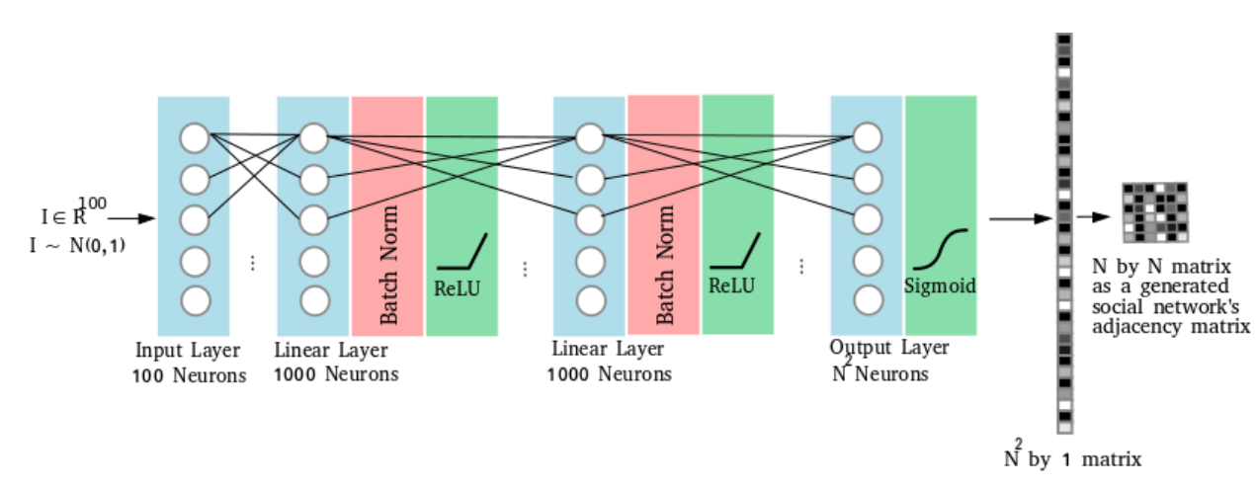
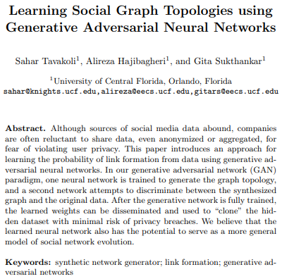
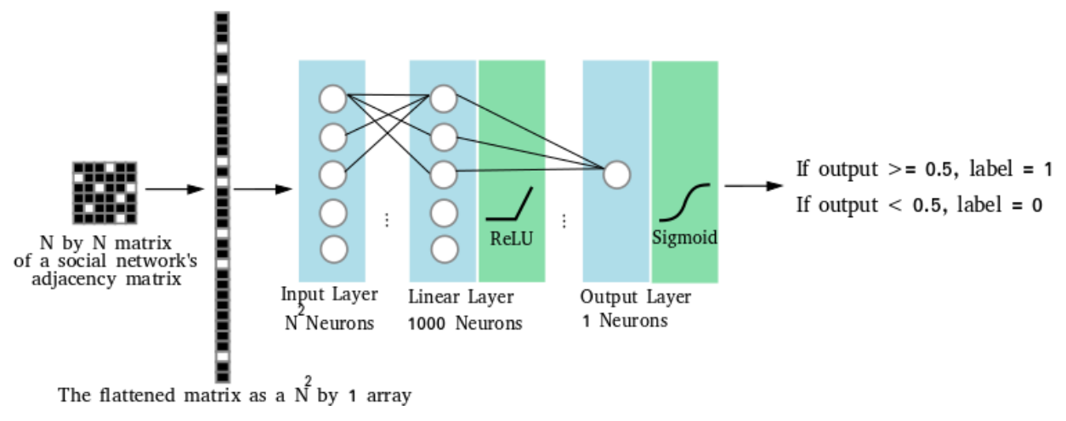
Learning social Graph using GAN
Learning social Graph using topologies using GANs
Tavakoli, Sahar, Alireza Hajibagheri, and Gita Sukthankar. "Learning social graph topologies using generative adversarial neural networks." International Conference on Social Computing, Behavioral-Cultural Modeling & Prediction. 2017.

Slide 6
Learning social Graph using GAN
Learning social Graph using topologies using GANs
A
A
B
C
D
A
B
C
D
B
A
0
1
0
0
A
1
B
1
0
1
1
B
1
1
1
C
0
1
0
1
C
1
1
C
D
0
1
1
0
D
1
1
D
G
Adj(G)
Img

Slide 7
Learning social Graph using GAN
Learning social Graph using topologies using GANs
Img
A
B
C
D
A
C
B
D
A
A
1
A
B
B
1
1
1
C
1
1
C
1
1
B
1
1
D
1
1
D
1
1
C
A
D
C
B
D
B
C
A
A
D
1
D
D
1
1
B
1
1
1
C
1
1
C
1
G
B
1
1
A
1

Slide 8
Learning social Graph using GAN
Learning social Graph using topologies using GANs
1
1
1
1
1
1
1
1
1
1
1
1
1
1
1
1
1
1
1
1
1
1
Training Set
1
1
1
sample
1
Discriminator
Real or Fake?
Generator
sample
Random
noise Z

Slide 9


Learning social Graph using GAN
Learning social Graph using topologies using GANs
Generator
INPUT
$$I∈R^{100}$$
$$I\sim N(0,1)$$
100
neurons
1000
neurons
1000
neurons
BN
ReLU
Sigmoid
BN
ReLU
NxN
neurons

Slide 10
Learning social Graph using GAN
Learning social Graph using topologies using GANs
Discriminator
Out >= 0.5 -> 1
Out < 0.5 -> 0
1
neurons
Sigmoid
1000
neurons
ReLU
NxN
neurons

Slide 11
Learning social Graph using GAN
Learning social Graph using topologies using GANs
Original graph와 Generated graph 간의 특징 비교(Nb nodes, nb.edges, avg. degree, diameter etc ..)
여러 소셜 상호작용 네트워크(Karate club, Football, Dolphins, Enron)

Slide 12
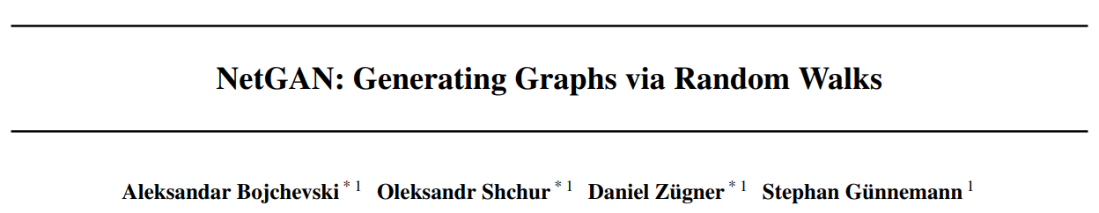
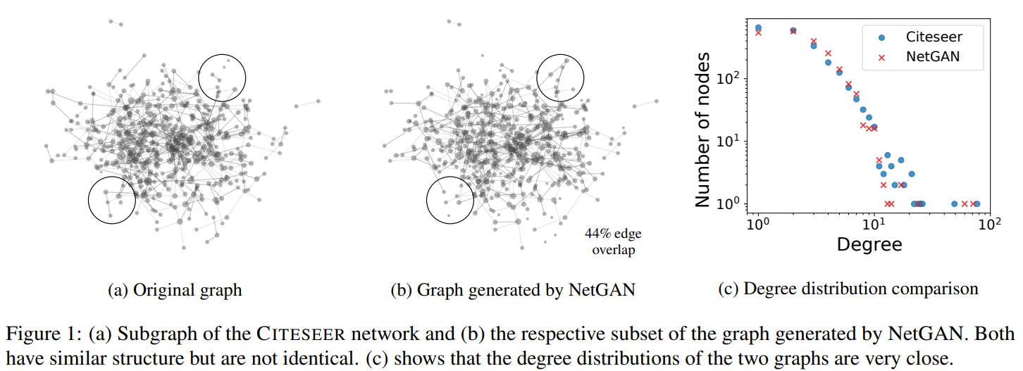
NetGAN
NetGAN: Generating Graphs via Random Walks
BOJCHEVSKI, Aleksandar, et al. Netgan: Generating graphs via random walks.
In: International conference on machine learning. PMLR, 2018. p. 610-619.

Slide 13
NetGAN
NetGAN: Generating Graphs via Random Walks
Training Set
sample
Discriminator
Real or Fake?
sample
Generator
Random
noise Z

Slide 14

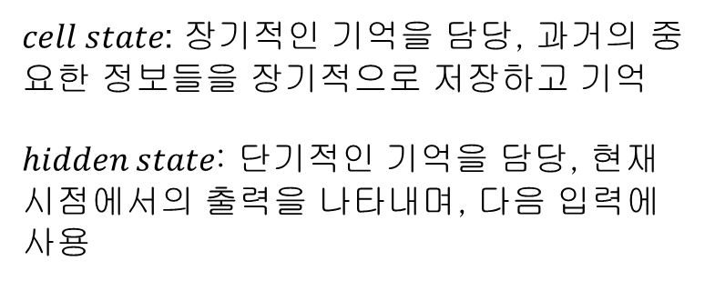

NetGAN
NetGAN: Generating Graphs via Random Walks
Generator
$cell state$: 장기적인 기억을 담당, 과거의 중요한 정보들을 장기적으로 저장하고 기억
$hidden state$: 단기적인 기억을 담당, 현재 시점에서의 출력을 나타내며, 다음 입력에 사용
40
neurons
Tanh
$C_{0}$: $cell state$
Z
Z
Z
Tanh
16 random
input
$$h_{0}:hidden state$$
40
neurons

Slide 15






NetGAN
NetGAN: Generating Graphs via Random Walks
Generator
$$W_{up}$$
$$O_{0}$$
LSTM CELL
$$C_{0}$$
$$C_{1}$$
Z
$$h_{0}$$
$$h_{1}$$

Slide 16





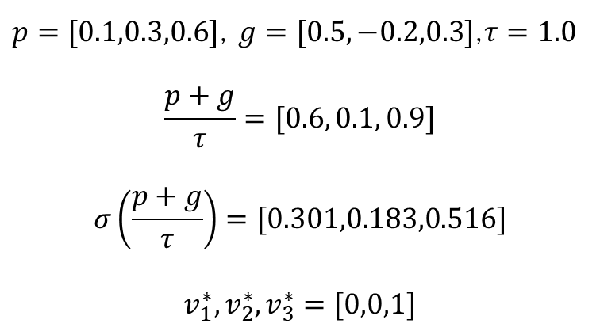



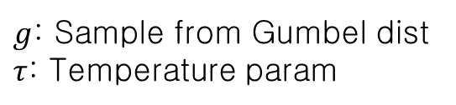




NetGAN
NetGAN: Generating Graphs via Random Walks
$$σ\left(\frac{p_{1}+g}{τ}\right)=v_{1}^{∗}$$
$$p_{1}$$
$$v_{1}^{∗}$$
$$p_{2}$$
$$v_{2}^{∗}$$
$g$: Sample from Gumbel dist
$τ$: Temperature param
$$p_{3}$$
$$v_{3}^{∗}$$
$$p_{4}$$
$$v_{4}^{∗}$$
$$W_{up}$$
$p=[0.1,0.3,0.6]$, $g=[0.5,−0.2,0.3]$,$τ=1.0$
$$\frac{p+g}{τ}=[0.6, 0.1, 0.9]$$
$$σ\left(\frac{p+g}{τ}\right)=[0.301,0.183,0.516]$$
$$v_{1}^{∗},v_{2}^{∗},v_{3}^{∗}=[0,0,1]$$
…
…
40
neurons
$$p_{N}$$
$$v_{N}^{∗}$$
N neurons

Slide 17
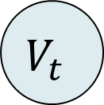
NetGAN
NetGAN: Generating Graphs via Random Walks
Arg max
$$p_{1}$$
$$v_{1}^{∗}$$
0
$$p_{2}$$
$$v_{2}^{∗}$$
1
$$p_{3}$$
$$v_{3}^{∗}$$
0
$$p_{4}$$
$$v_{4}^{∗}$$
onehot
0
$$W_{up}$$
$$V_{t}$$
0
…
…
…
0
0
40
neurons
$$p_{N}$$
$$v_{N}^{∗}$$
0
N neurons

Slide 18


NetGAN
NetGAN: Generating Graphs via Random Walks
Generator
$$V_{1}$$
$$W_{up}$$
$$O_{0}$$
LSTM CELL
$$C_{0}$$
$$C_{1}$$
Z
$$h_{0}$$
$$h_{1}$$
$$W_{down}$$

Slide 19

NetGAN
NetGAN: Generating Graphs via Random Walks
$$W_{down}$$
40
neurons
N neurons

Slide 20

















NetGAN
NetGAN: Generating Graphs via Random Walks
Generator
$$V_{1}$$
$$V_{2}$$
$$V_{1}$$
$$V_{2}$$
$$V_{1}$$
$$V_{2}$$
$$V_{T}$$
$$V_{T}$$
$$W_{up}$$
$$W_{up}$$
$$W_{up}$$
$$O_{0}$$
$$O_{1}$$
$$O_{T}$$
LSTM CELL
LSTM CELL
LSTM CELL
$$C_{0}$$
$$C_{1}$$
$$C_{T−1}$$
$$C_{T}$$
$$…$$
Z
$$h_{0}$$
$$h_{1}$$
$$h_{T−1}$$
$$h_{T}$$
$$W_{down}$$
$$W_{down}$$
$$W_{down}$$

Slide 21



NetGAN
NetGAN: Generating Graphs via Random Walks
Discriminator
0
1
$$V_{2}$$
0
0
LSTM
$$V_{5}$$
0
…
0
$$V_{T}$$
0
0

Slide 22
NetGAN
NetGAN: Generating Graphs via Random Walks
Discriminator
0
0
$$V_{2}$$
0
0
LSTM
$$V_{5}$$
1
0
0
$$V_{T}$$
0
0

Slide 23
NetGAN
NetGAN: Generating Graphs via Random Walks
Discriminator
0
0
$$V_{2}$$
True
0
0
LSTM
$$V_{5}$$
1
0
0
Fake
$$V_{T}$$
0
0

Slide 24
NetGAN
When to stop the training process?
VAL-CRITERION: 1000번의 Epoch에서 생성된 랜덤 워크를 슬라이딩 윈도우 방식으로 저장하여, 전이 횟수 행렬(transition count matrix)을 구성한다. 이후 링크 예측 성능을 검증 세트에 평가하여 검증 성능이 개선되지 않으면 훈련을 종료
EO-CRITERION: 생성된 그래프와 원본 그래프간 사용자가 지정한 edge overlap을 달성 했을 때 종료

Slide 25
NetGAN
How to build the graph?
0
10
2
0
1
…
…
…
…
2
Generator
sample
Random
noise Z
…
…
…
…
…
…
…
…
…
…
…
…
…
…
…
transition count matrix

Slide 26
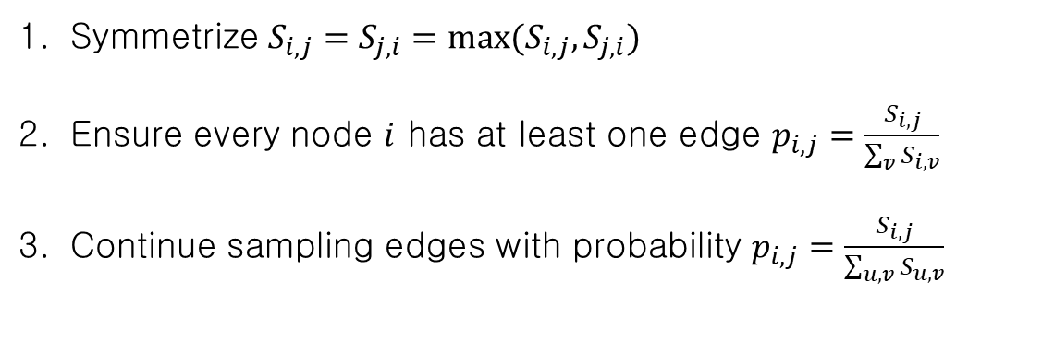
NetGAN
How to build the graph?
0
10
2
0
1
…
…
…
…
2
Symmetrize $S_{i,j}=S_{j,i}=max⁡(S_{i,j}, S_{j,i})$
Ensure every node $i$ has at least one edge $p_{i,j}=\frac{S_{i,j}}{\sum_{v}{S_{i,v}}}$
Continue sampling edges with probability $p_{i,j}=\frac{S_{i,j}}{\sum_{u,v}{S_{u,v}}}$
…
…
…
…
…
…
…
…
…
…
…
…
…
…
…
transition count matrix

Slide 27
NetGAN
How to build the graph?
A
B
C
D
E
A
0
10
2
0
1
B
5
0
2
0
2
Generator
sample
Random
noise Z
C
2
1
0
0
0
D
0
1
0
0
0
C
B
A
E
0
2
0
0
0
B
A
E
B
A
transition count matrix
C
A
E
B
…

Slide 28
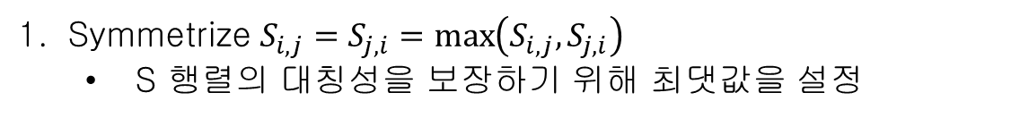
NetGAN
How to build the graph?
A
B
C
D
E
Symmetrize $S_{i,j}=S_{j,i}=\max\left(S_{i,j}, S_{j,i}\right)$
S 행렬의 대칭성을 보장하기 위해 최댓값을 설정
A
0
10
2
0
1
A
B
C
D
E
B
5
0
2
0
2
A
0
10
2
0
1
C
2
1
0
0
0
B
10
0
2
1
2
D
0
1
0
0
0
C
2
2
0
0
0
E
0
2
0
0
0
D
0
1
0
0
0
E
1
2
0
0
0
transition count matrix
transition count matrix

Slide 29
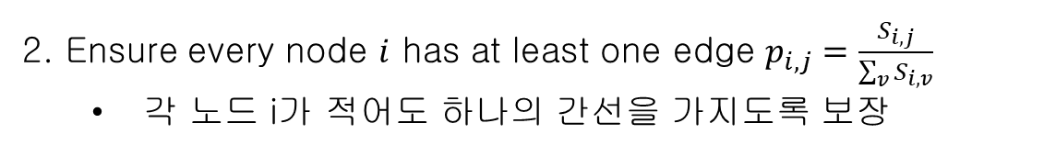
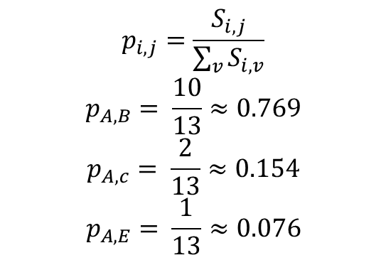
NetGAN
How to build the graph?
2. Ensure every node $i$ has at least one edge $p_{i,j}=\frac{S_{i,j}}{\sum_{v}{S_{i,v}}}$
각 노드 i가 적어도 하나의 간선을 가지도록 보장
A
B
C
D
E
A
0
10
2
0
1
A
B
C
D
E
B
10
0
2
1
2
$$p_{i,j}=\frac{S_{i,j}}{\sum_{v}{S_{i,v}}}$$
$$p_{A,B}= \frac{10}{13}≈0.769$$
$$p_{A,c}= \frac{2}{13}≈0.154$$
$$p_{A,E}= \frac{1}{13}≈0.076$$
A
0
1
1
0
1
C
2
2
0
0
0
B
1
0
1
1
1
D
0
1
0
0
0
C
1
1
0
0
0
E
1
2
0
0
0
D
0
1
0
0
0
E
1
1
0
0
0
transition count matrix
transition count matrix

Slide 30
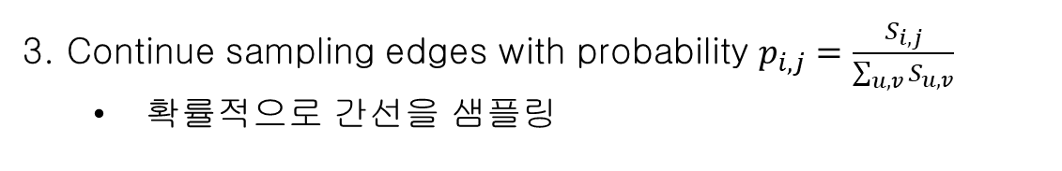
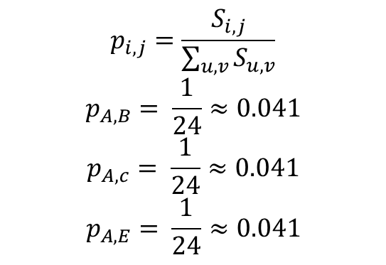
NetGAN
How to build the graph?
3. Continue sampling edges with probability $p_{i,j}=\frac{S_{i,j}}{\sum_{u,v}{S_{u,v}}}$
확률적으로 간선을 샘플링
A
B
C
D
E
A
0
1
1
0
1
A
B
C
D
E
B
1
0
1
1
1
$$p_{i,j}=\frac{S_{i,j}}{\sum_{u,v}{S_{u,v}}}$$
$$p_{A,B}= \frac{1}{24}≈0.041$$
$$p_{A,c}= \frac{1}{24}≈0.041$$
$$p_{A,E}= \frac{1}{24}≈0.041$$
A
0
1
0
0
1
C
1
1
0
0
0
B
1
0
1
1
1
D
0
1
0
0
0
C
0
1
0
0
0
E
1
1
0
0
0
D
0
1
0
0
0
E
1
1
0
0
0
transition count matrix
transition count matrix

Slide 31
NetGAN
How to build the graph?
3. Continue sampling edges with probability $p_{i,j}=\frac{S_{i,j}}{\sum_{u,v}{S_{u,v}}}$
확률적으로 간선을 샘플링
A
B
C
D
E
A
0
1
0
0
1
A
B
1
0
1
1
1
C
0
1
0
0
0
B
E
D
0
1
0
0
0
E
1
1
0
0
0
C
D
transition count matrix
G

Slide 32
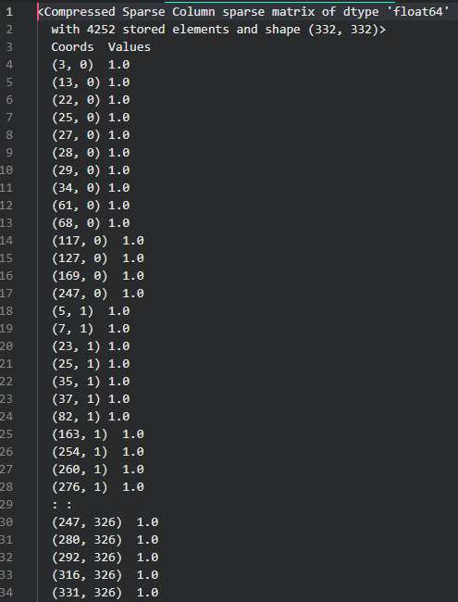
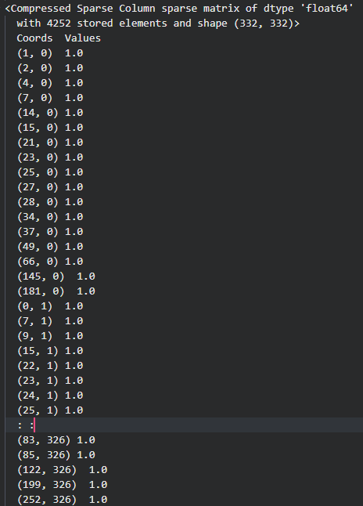
NetGAN
How to build the graph?

Slide 33
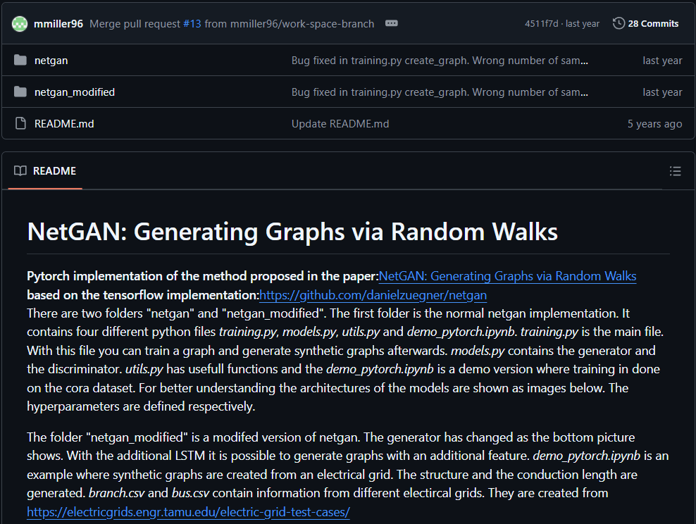
NetGAN
How to build the graph?
https://github.com/mmiller96/netgan_pytorch?tab=readme-ov-file

Slide 34
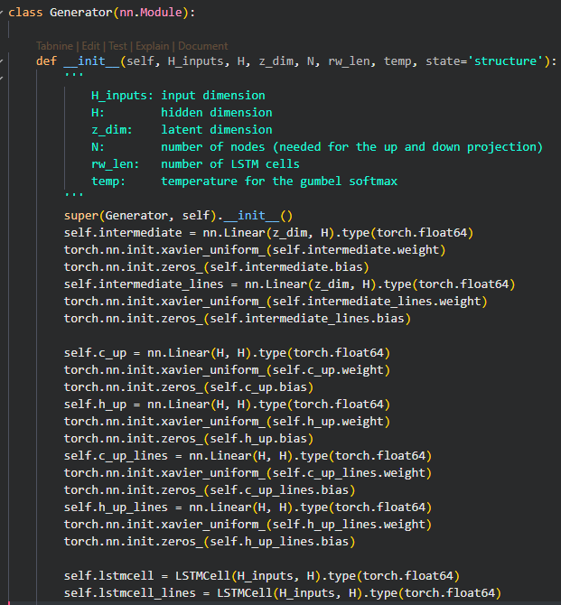
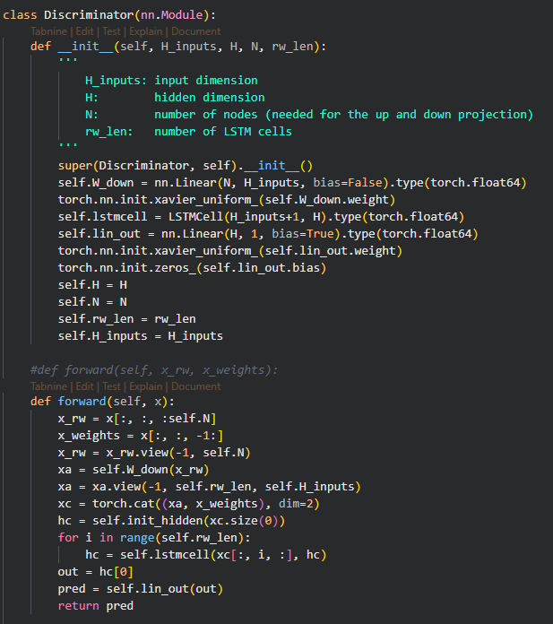
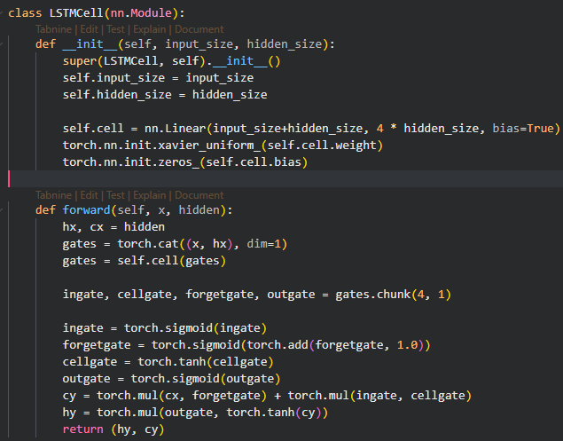
NetGAN
code

Slide 35
NetGAN
Trainer Parameters
Parameter | Description | Default Value
graph | Graph (scipy sparse matrix) | scipy sparse matrix
graph_weighted | Weighted graph | scipy sparse matrix
scaler | Scaler object | Scaler
N | Number of nodes in the graph to generate | int
rw_len | Length of random walks to generate | 16
batch_size | The batch size. | 128
H_gen | The hidden_size of the generator. | 40
H_disc | The hidden_size of the discriminator | 30
H_inp | Inputsize of the LSTM-Cells | 128
z_dim | The dimension of the random noise that is used as input to the generator. | 16
lr | The Learning rate will be used for the generator as well as for the discriminator | 0.0003
Parameter | Description | Default Value
n_critic | The number of discriminator iterations per generator training iteration | 3
gp_weight | Gradient penalty weight for the Wasserstein GAN | 10.0
betas | Decay rates of the Adam Optimizers | (0.5, 0.9)
l2_penalty_disc | L2 penalty on the discriminator weights | 5e-5
l2_penalty_gen | L2 penalty on the generator weights | 1e-7
temp_start | The initial temperature for the Gumbel softmax | 5.0
temp_decay | Temperature decay for the Gumbel softmax | 1 - 5e-5
min_temp | The minimal temperature for the Gumbel softmax | 0.5
val_share | Percentage of validation edges | 0.1
test_share | Percentage of test edges | 0.1
seed | Seed for numpy.random | 498164
delta | Temperature value | 0.02

Slide 36
NetGAN
train Parameters
Parameter | Description | Default Value
create_graph_every | Creates every nth iteration a graph from randomwalks. | 2000
plot_graph_every | Plots the lost functions of the generator and discriminator. | 2000
num_samples_graph | Number of random walks that will be created for the graphs. Higher values mean more precise evaluations but also more computational time. | 10000
stopping_criterion | The stopping_criterion can be either 'val' or 'eo’: 'val': Stops the optimization if there are no improvements after several iterations. --> defined by max_patience 'eo': Stops if the edge overlap exceeds a certain treshold. --> defined by stopping_eo | val
max_patience | Maximum evaluation steps without improvement of the validation accuracy to tolerate. Only applies to the VAL criterion. | 5
stopping_eo | Stops when the edge overlap exceeds this threshold. Will be used when stopping_criterion is 'eo'. | 0.5

Slide 37
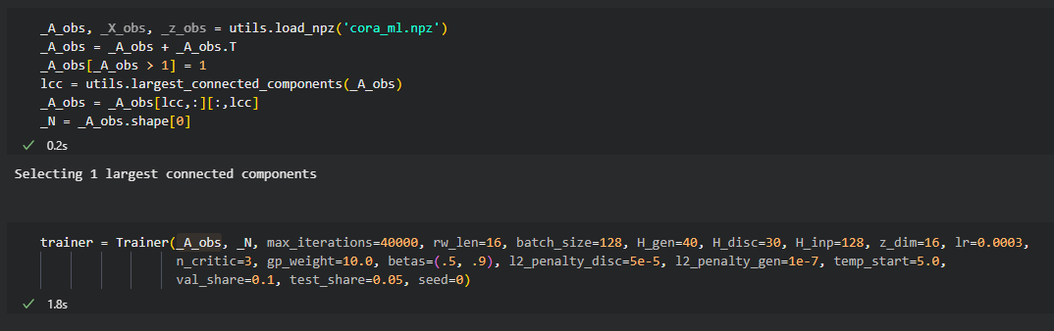
NetGAN
code

Slide 38
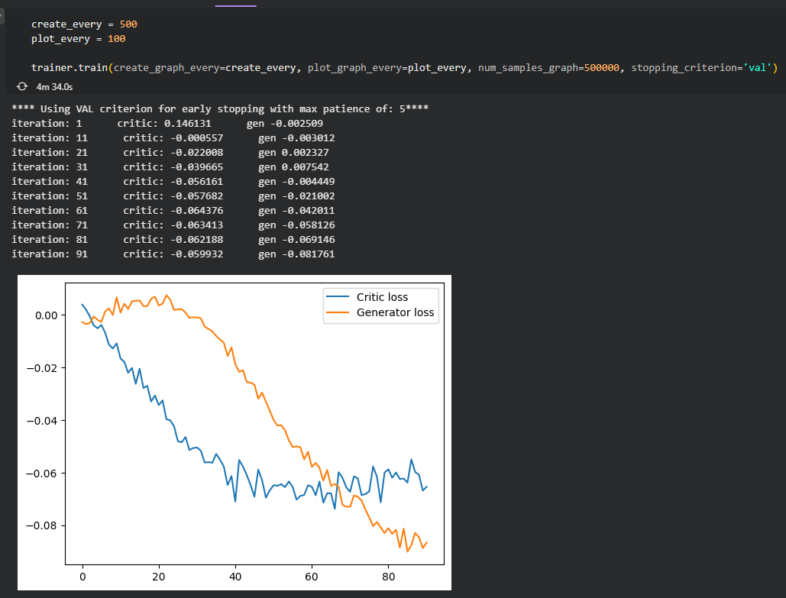
NetGAN
code

Slide 39
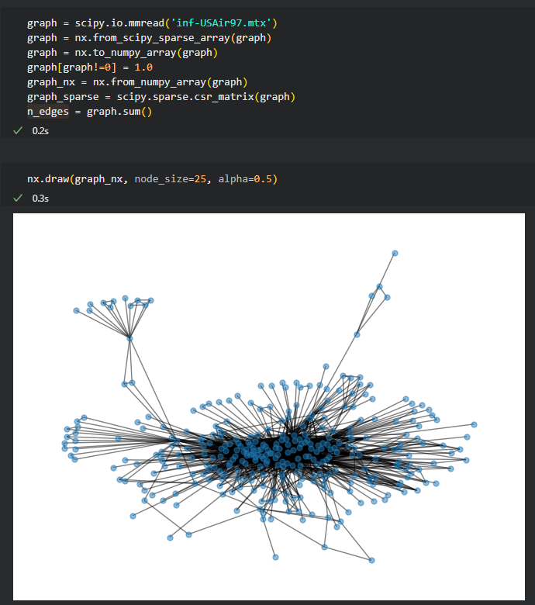
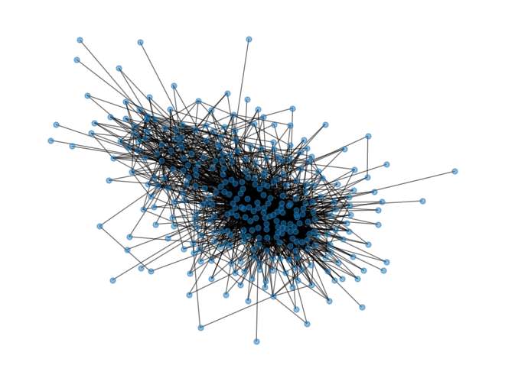
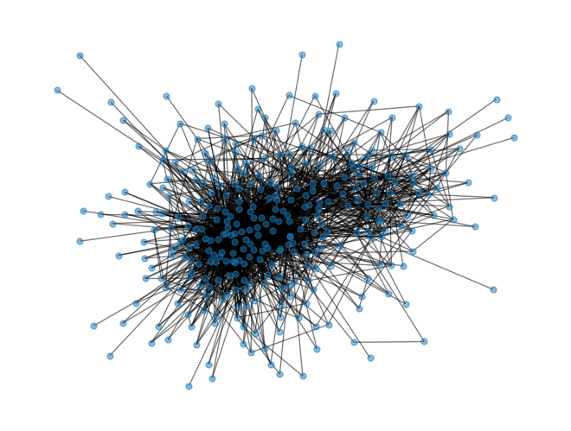
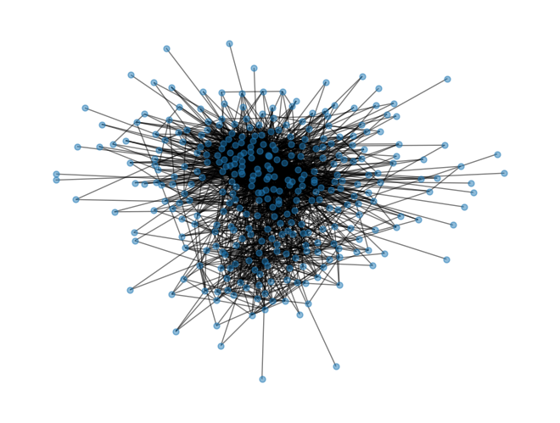
NetGAN
code

Slide 40
QnA.

Slide 41
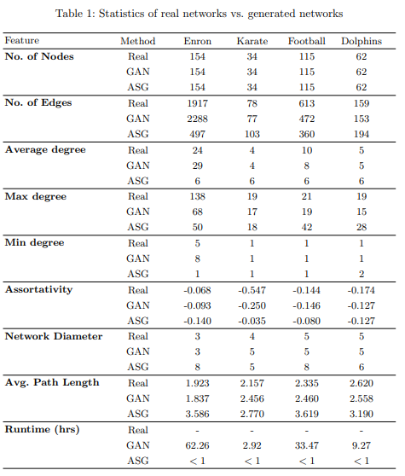
Table 1: Statistics of real networks vs. generated networks

